Slide 1
Football Squad Builder Hobby Project
By Lewis Pearson
29/07/2022

Slide 2
Introduction
Lewis Pearson, Mechanical Engineering graduate and Tech Specialist at QA Ltd.
Project specification is to design an application related to a hobby. For this project I’ve created a football squad builder.

Slide 3
Project Approach
Another good opportunity to learn and gain experience with new technologies in a project development environment. Specifically front-end and Spring.
This project builds upon the last one as it demonstrates a simplified backend, and adds an accessible frontend.
Thorough planning and use of project management tools to ensure smooth development. Understanding project requirements is important.

Slide 4
What was used in this project?
Git for version control
GitHub for storing source code
Jira for managing the project through a Scrum Board with User Stories and Tasks
Java backend, with a Spring application, and Maven for dependency management and building
MySQL database
Junit for testing
HTML, CSS, and JavaScript for the frontend

Slide 5
How was version control used?
A version control system in Git was used in conjunction with the source code management website in GitHub. Additionally, Jira was used for user stories and setting out each task required in the project.
Commits were made frequently throughout the project to ensure work had been saved, and these were linked to Jira through smart commits allowing easy project tracking.
The feature-branch model was utilised to break the project into major features.

Slide 6
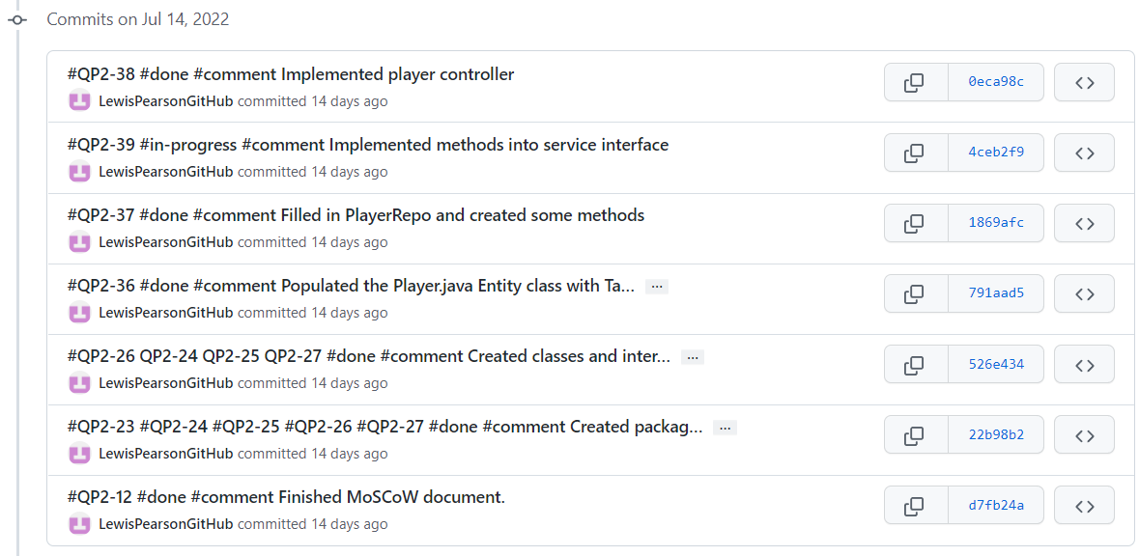
Git and GitHub

Slide 7
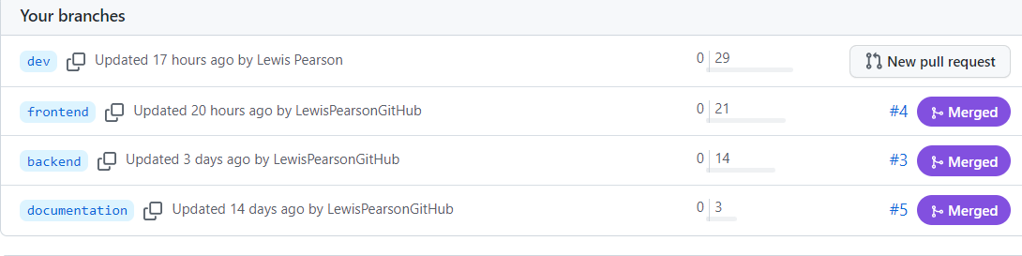

Slide 8
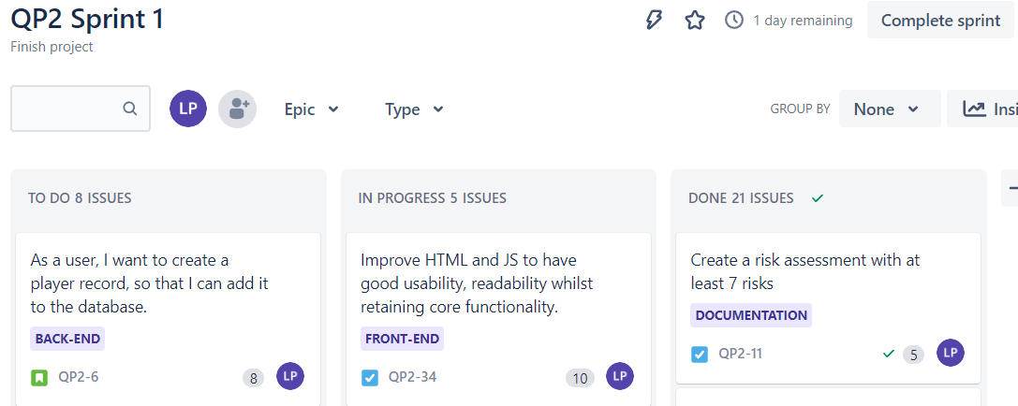
Jira

Slide 9
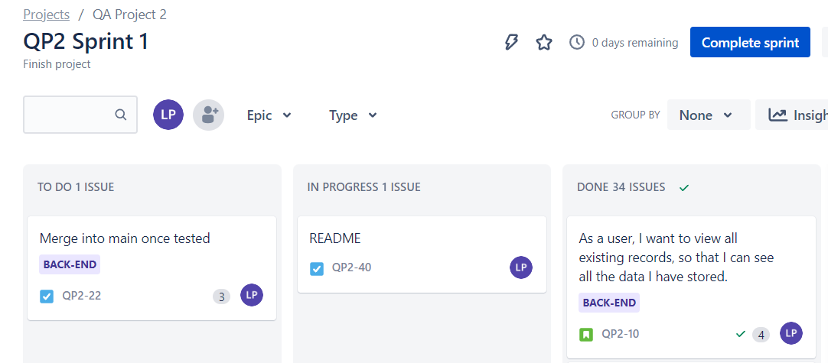

Slide 10
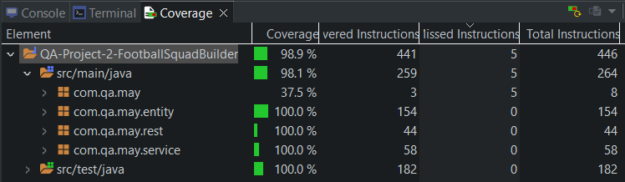
Testing
src/main/java covered 98.1% by testing.

Slide 11
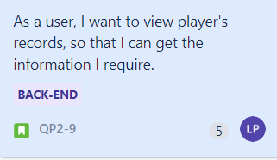
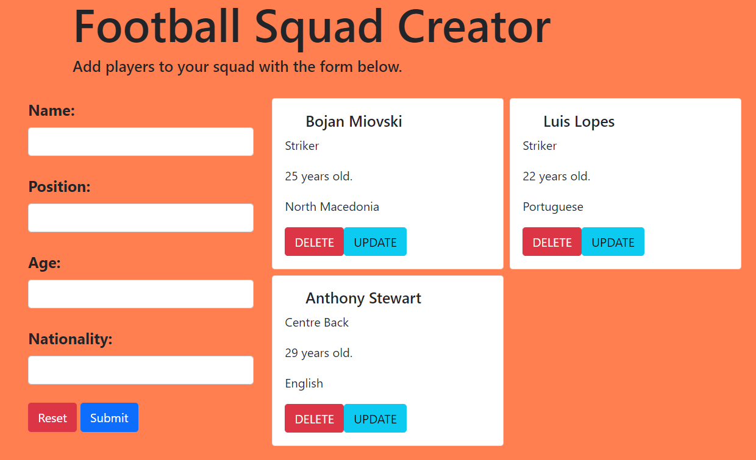
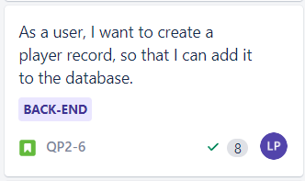
Demonstration

Slide 12
Sprint Review
Sprint review as of the time this presentation was given:
Completed work:
- Minimum Viable Product achieved to a good standard. Completed Risk Assessment, ERD, MoSCoW, UML, Wireframe documents.
- Test coverage of 98.1% in the backend
- Most tasks completed on project management board.

Slide 13
Sprint Review
Things left behind:
- Adding additional entities
- Search function
- Better frontend design
- Sonarqube

Slide 14
Sprint Retrospective
What could have been done better?
- The minimum viable product could have been completed earlier, allowing more time to refine the project and add additional features. However due to time constraints and disruption this would not have been easy.
- Better use of version control. Whilst the project did not have many features, perhaps more feature branches could have been utilised.
What went well?
MVP completed to a good understand and efficiently.
Good experience and knowledge gained in the use of frontend technologies and linking to the backend.

Slide 15
Conclusion
A successful project as the MVP was achieved and scope adhered to.
Lots learned regarding frontend and connecting to the backend. More experience in project planning and project management is very useful. Gaining familiarity with using the tools and technologies independently.

Slide 16
Future Steps
To finish off this project all that needs to be done is finishing the README file and merge into the main branch.
However, this is a project I could see myself adding onto in the future. I have some ideas that would improve the design and usability in the frontend whilst I would also like to add additional tables to store entire squads of players that could then be accessed. This would be a good challenge to make use of my skills as I get better with these technologies.

Slide 17
Any Questions?

